Slide 1


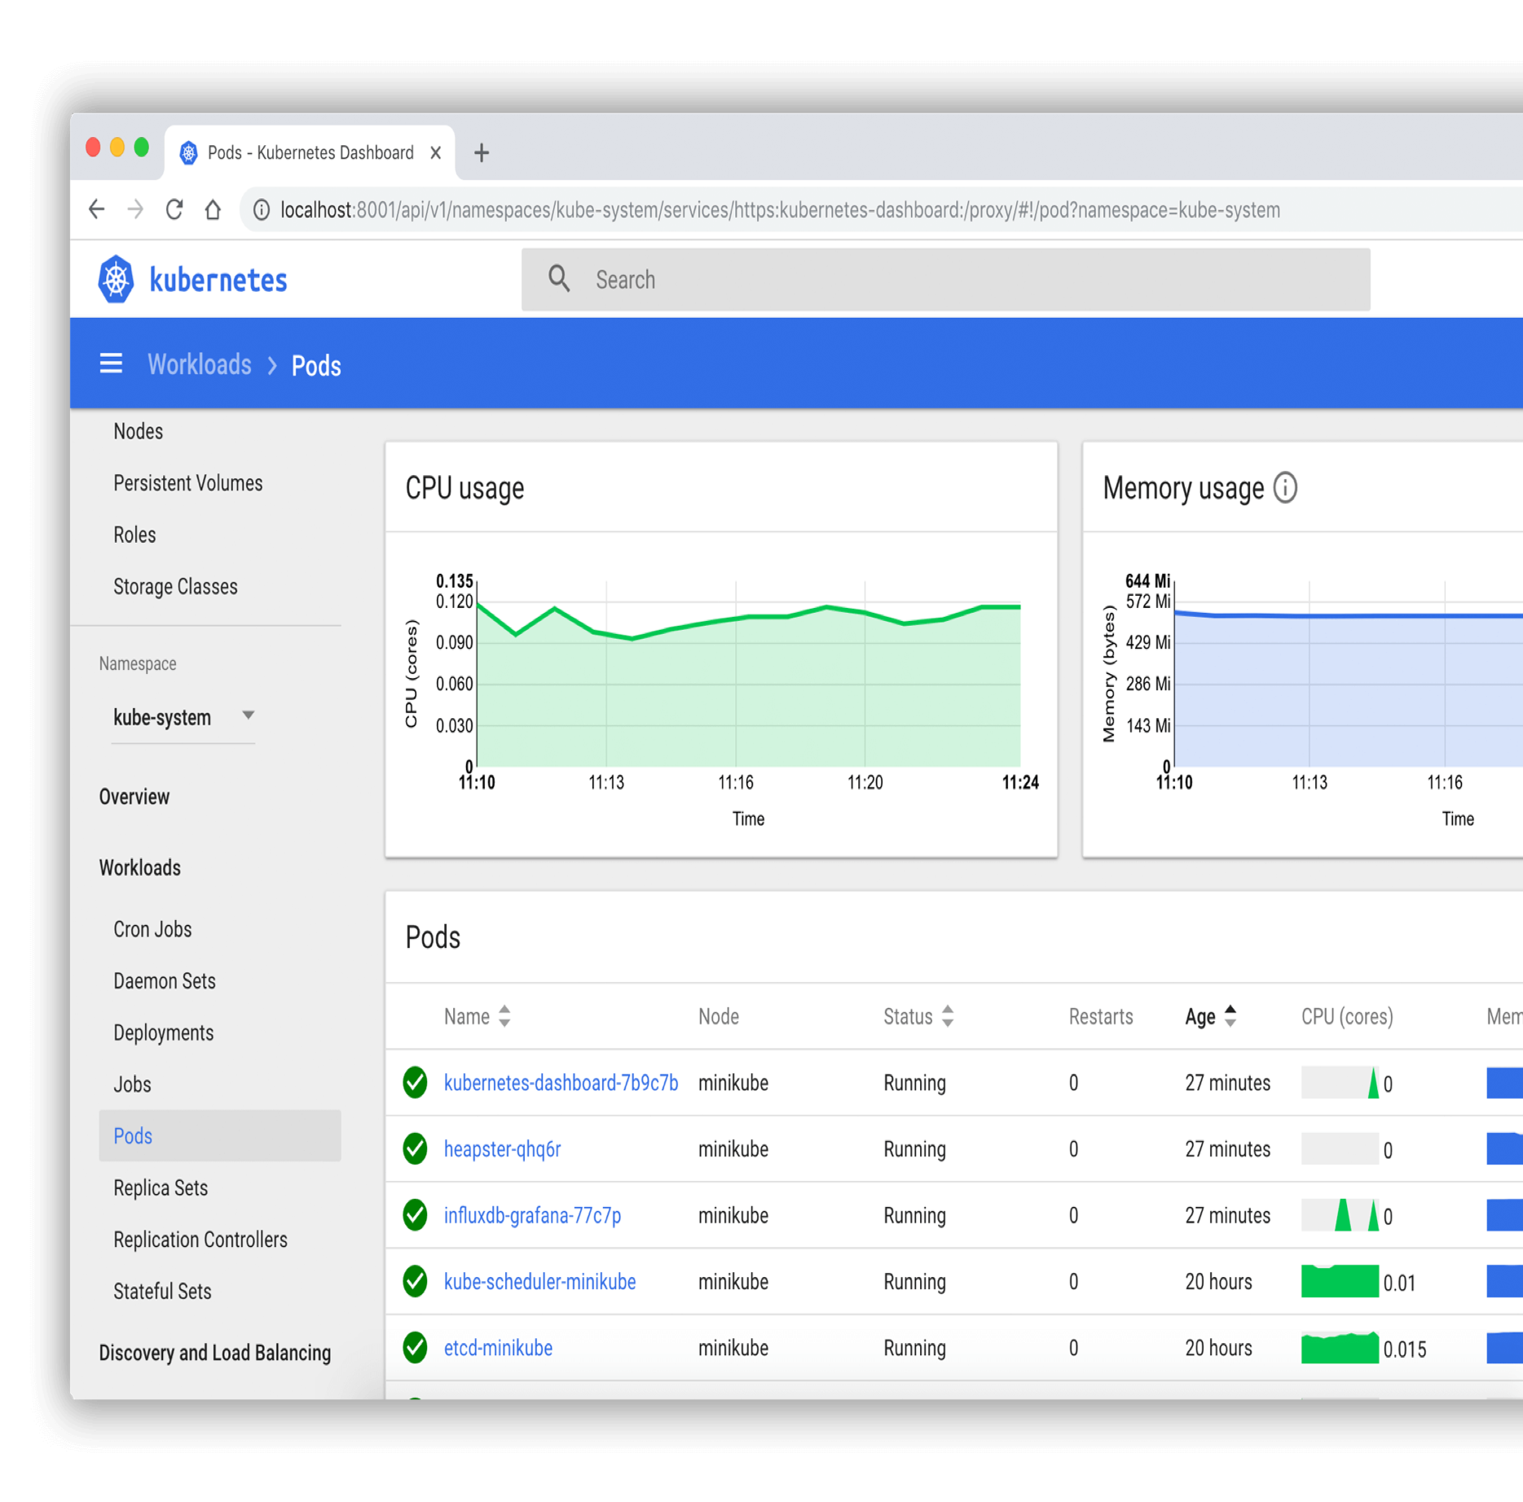
Practical Guide to Securing Kubernets(K8’s)

Slide 2

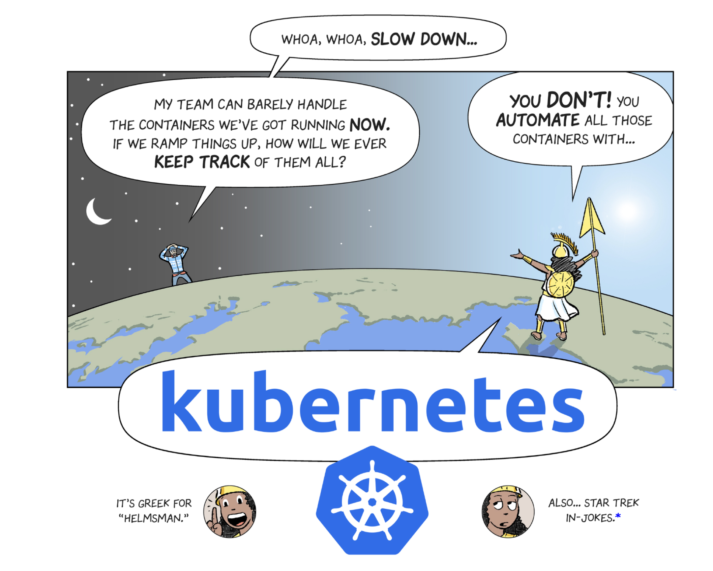





Scalable Container Management
Provisioning
Storage
Redundancy
Auto-Scaling
Security

Slide 3
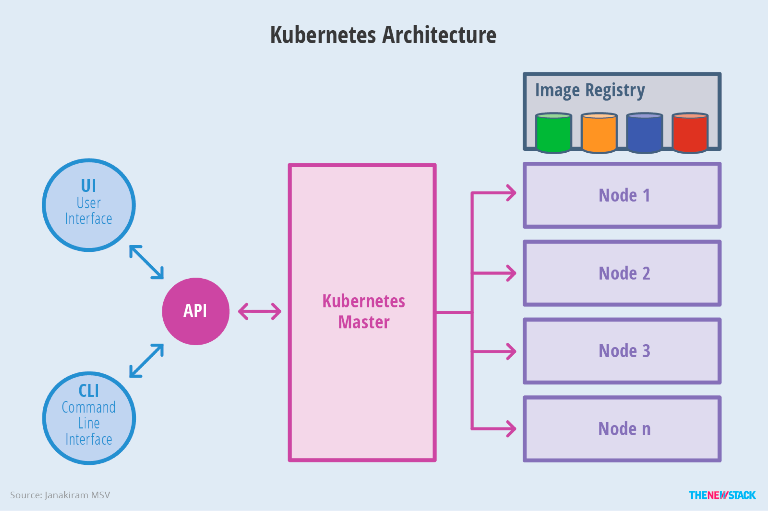













Slide 4



THREATS & RISKS FOR CLOUD WORKLOADS
Data leaks
Abuse & Nefarious Use
Information Disclosure
Service Losses

Slide 5

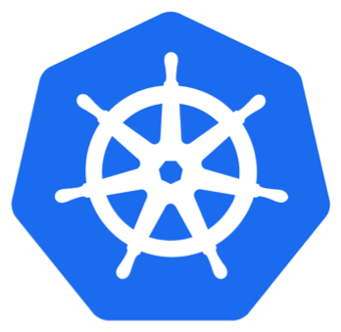

MAJOR THRE AT VECTORS
Outside the Cluster
Management Server UI
Inside the Cluster
Compromised Nodes
API Service
Compromised Pods
etcd
Compromised Accounts
Kubelet

Slide 6

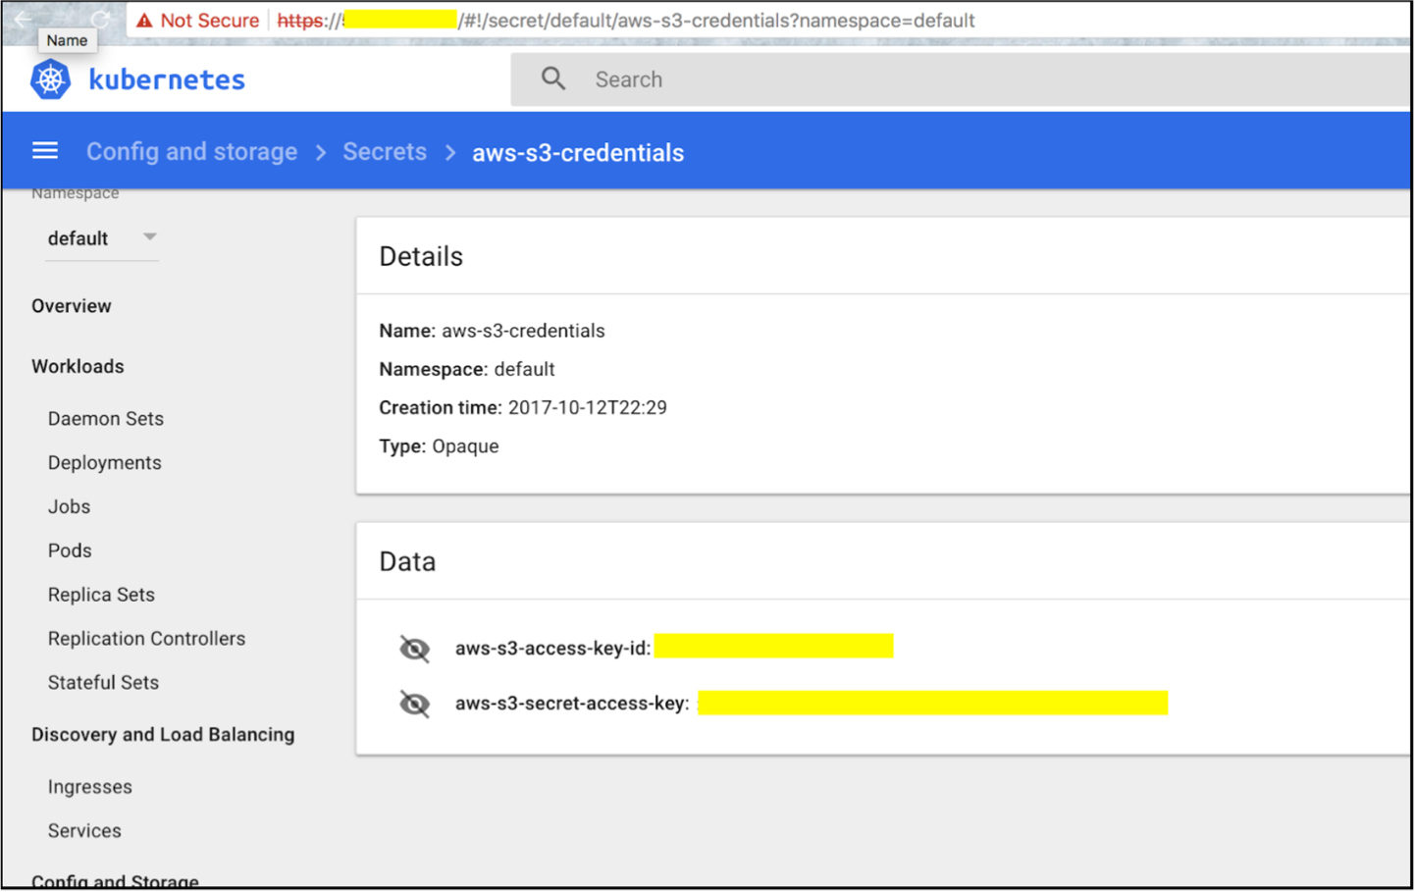



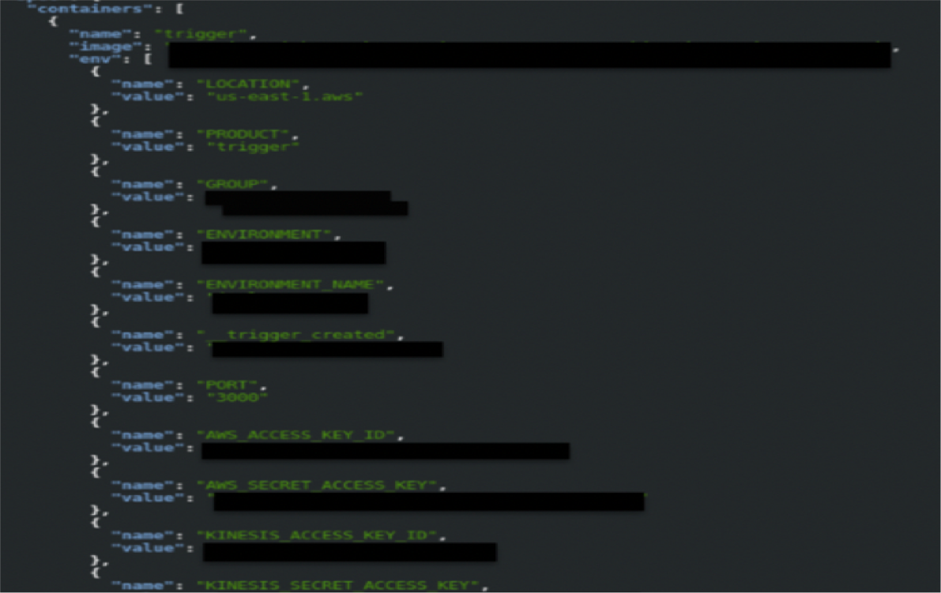


EXPOSED DASHBOARDS

Slide 7

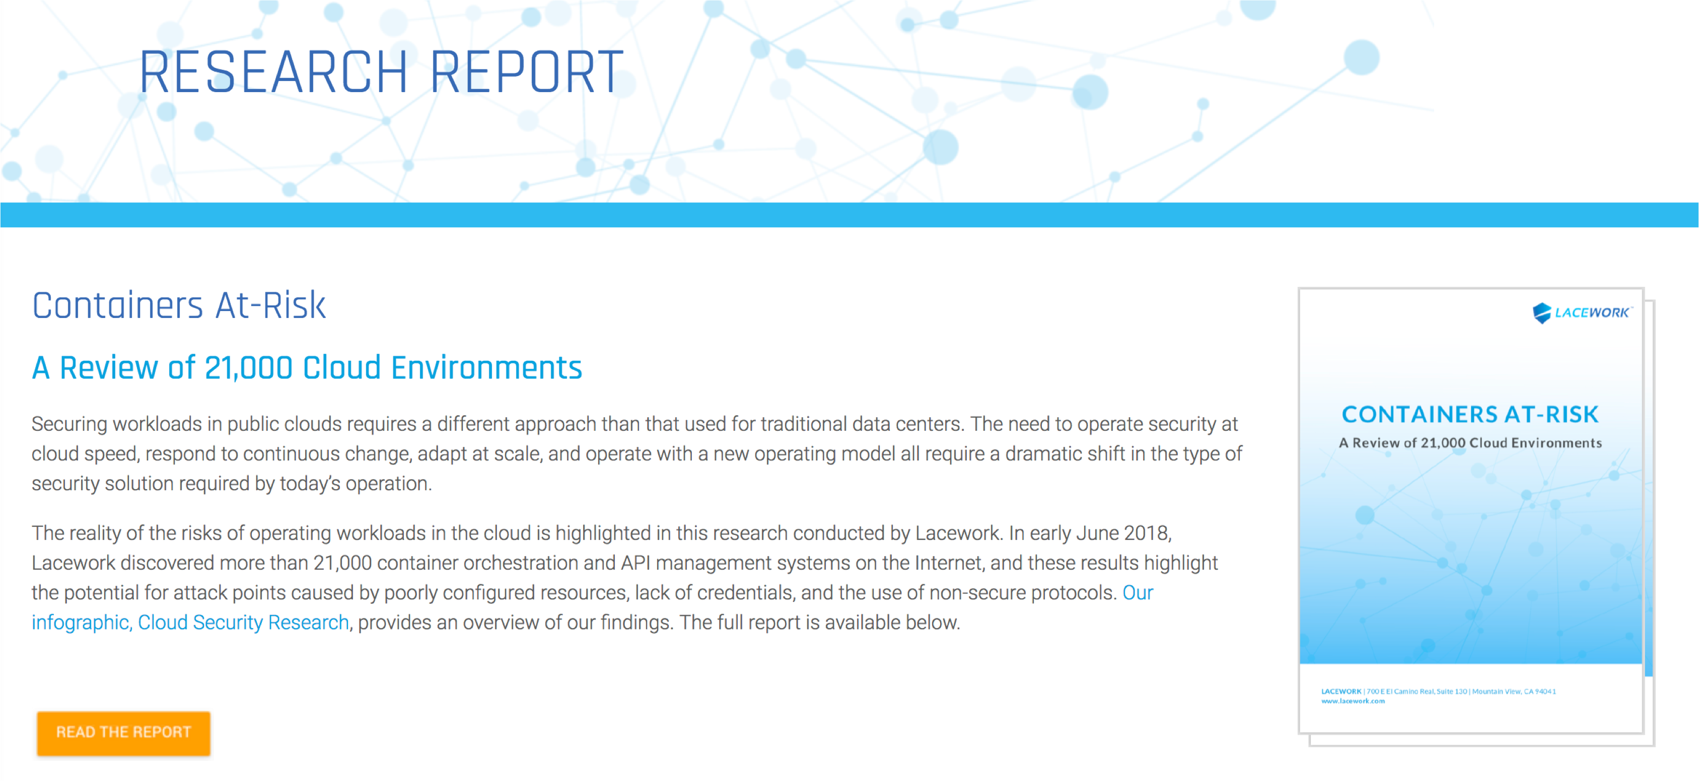
EXPOSED DASHBOARDS

Slide 8
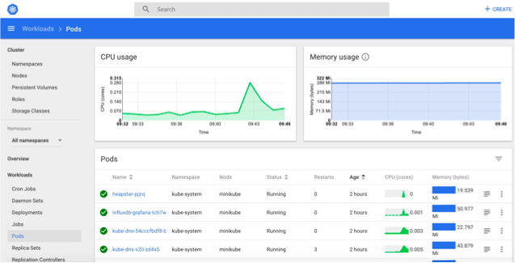
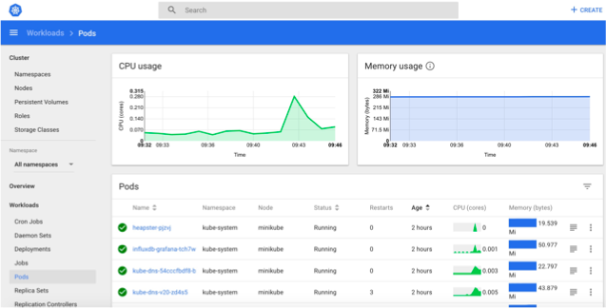


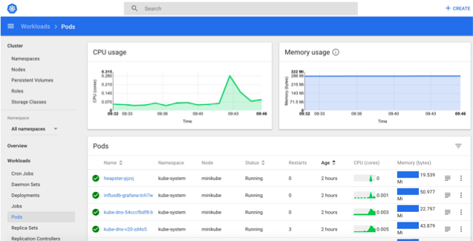

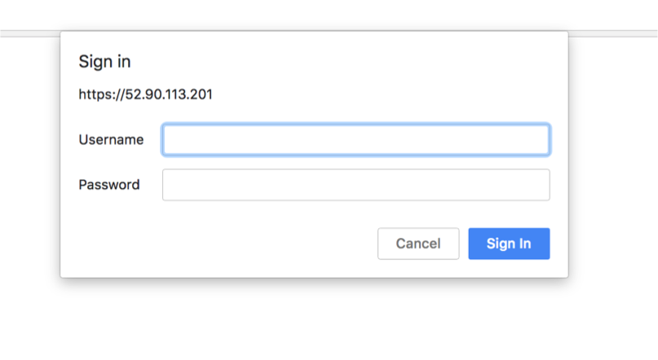
DISCOVERING DASHBOARDS WITH SHODAN

Slide 9
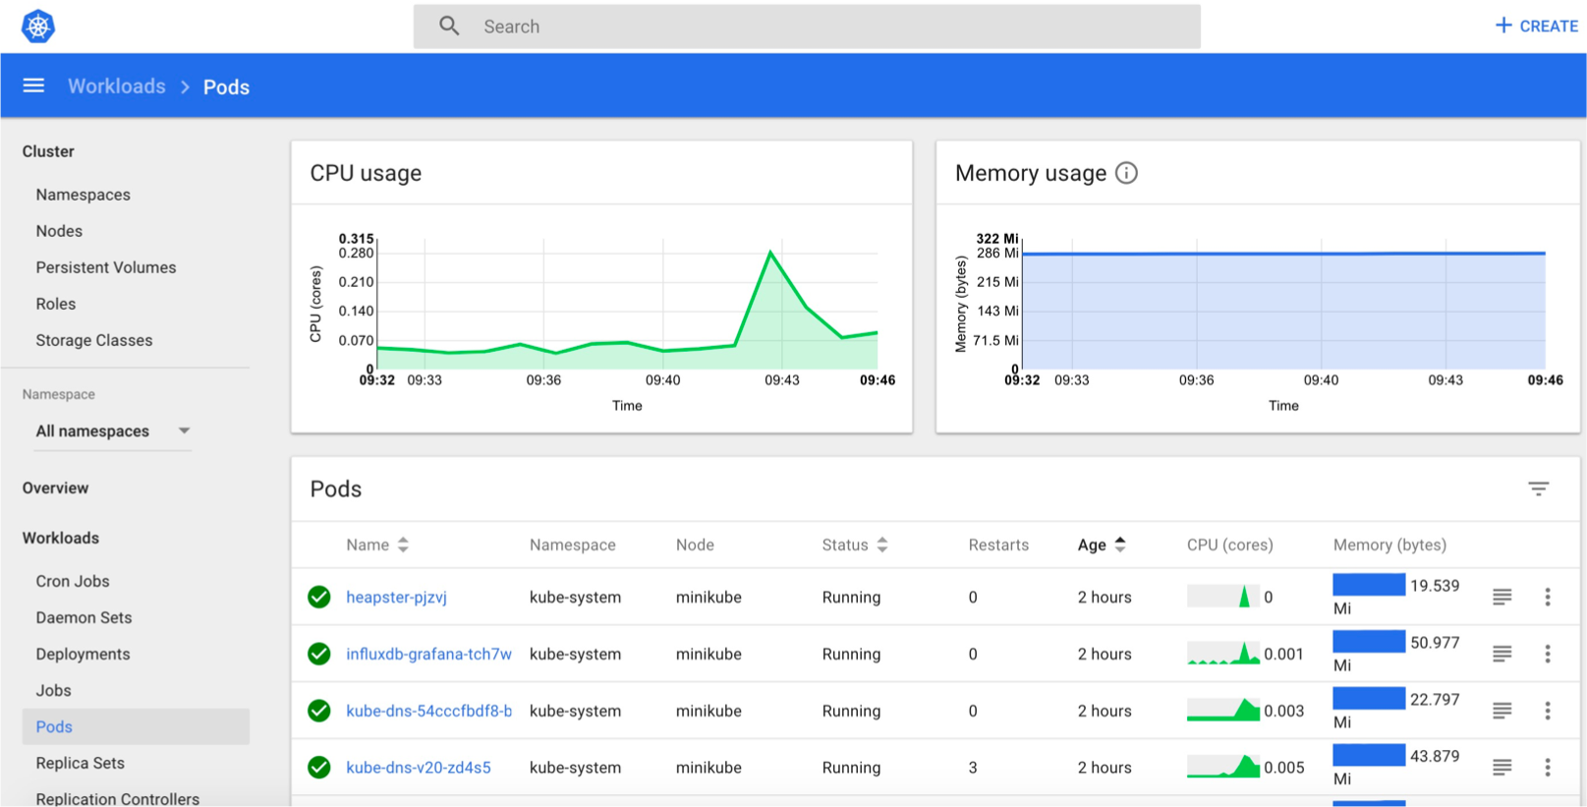
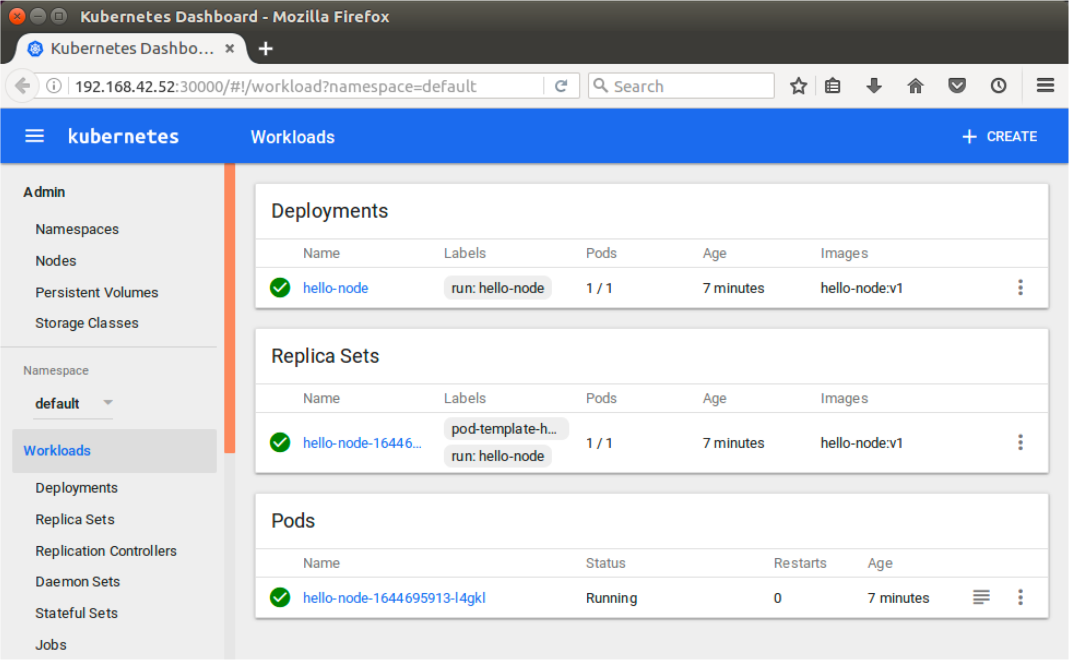
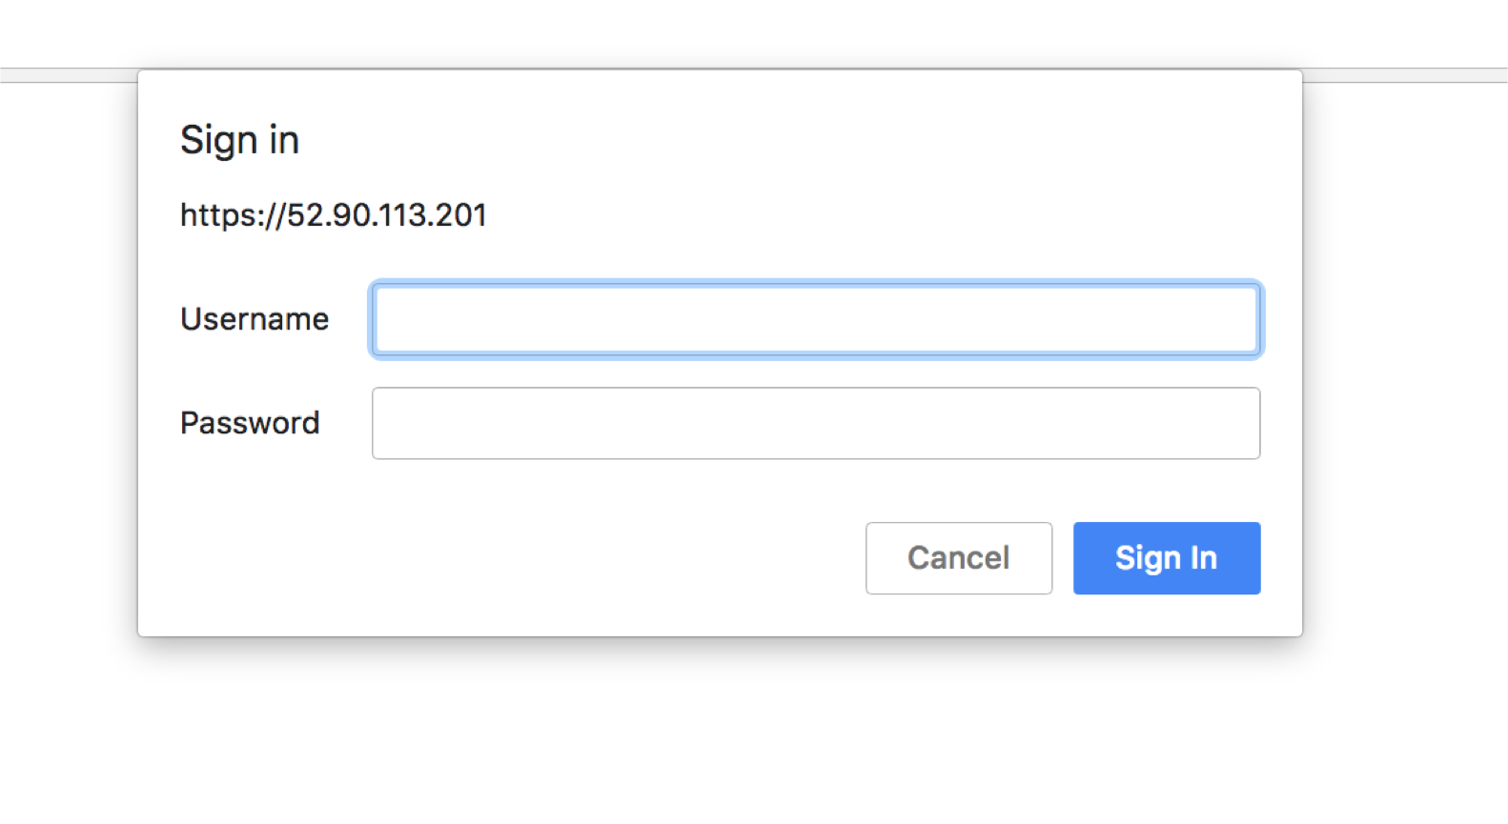
EXPOSED DASHBOARDS

Slide 10
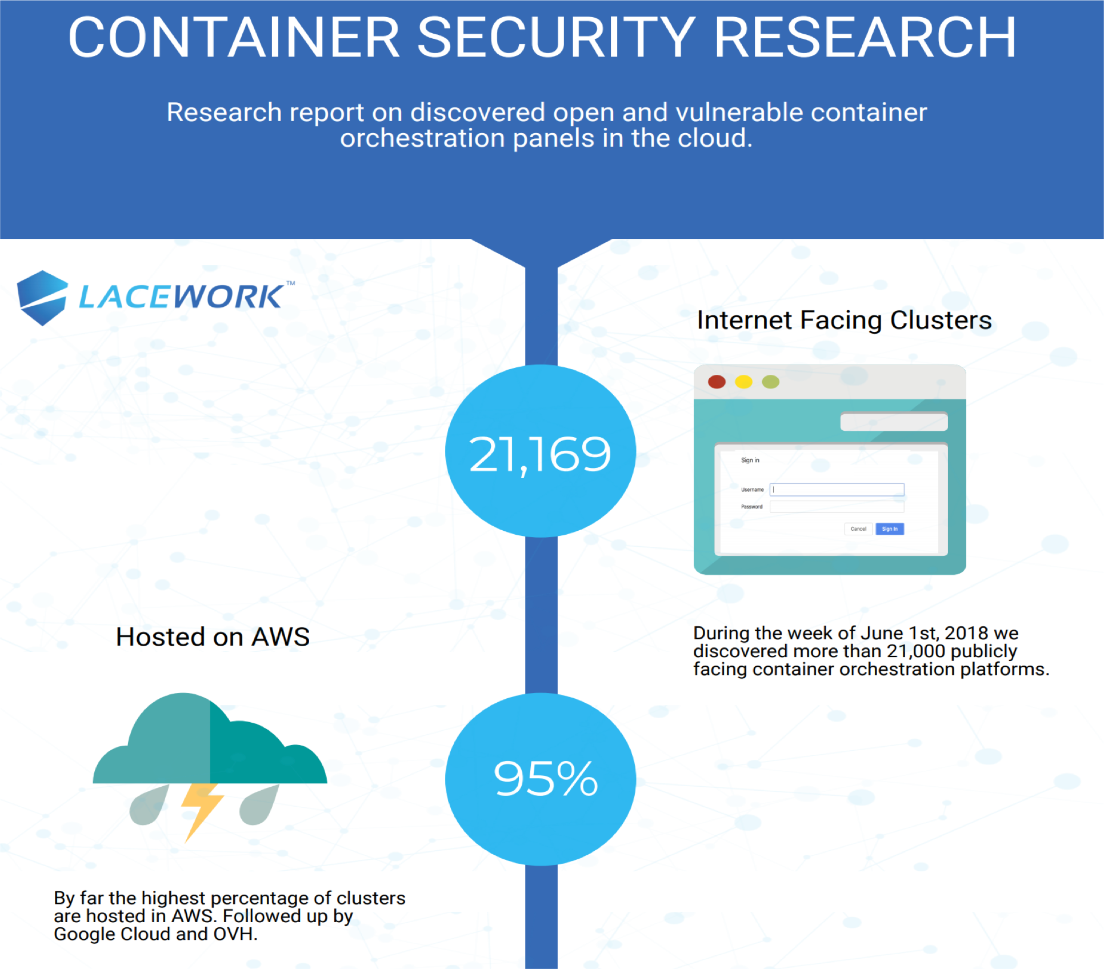
EXPOSED DASHBOARDS

Slide 11
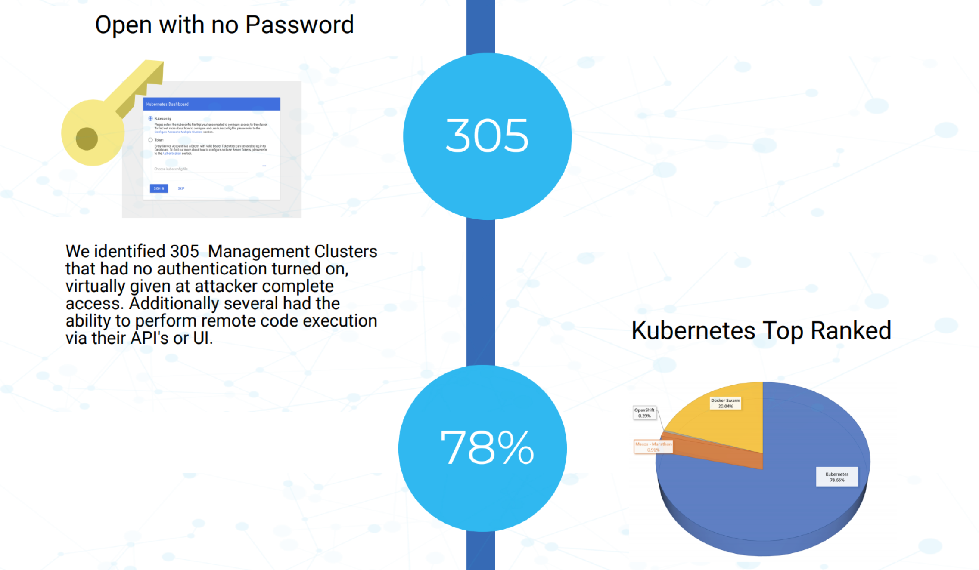
EXPOSED DASHBOARDS

Slide 12
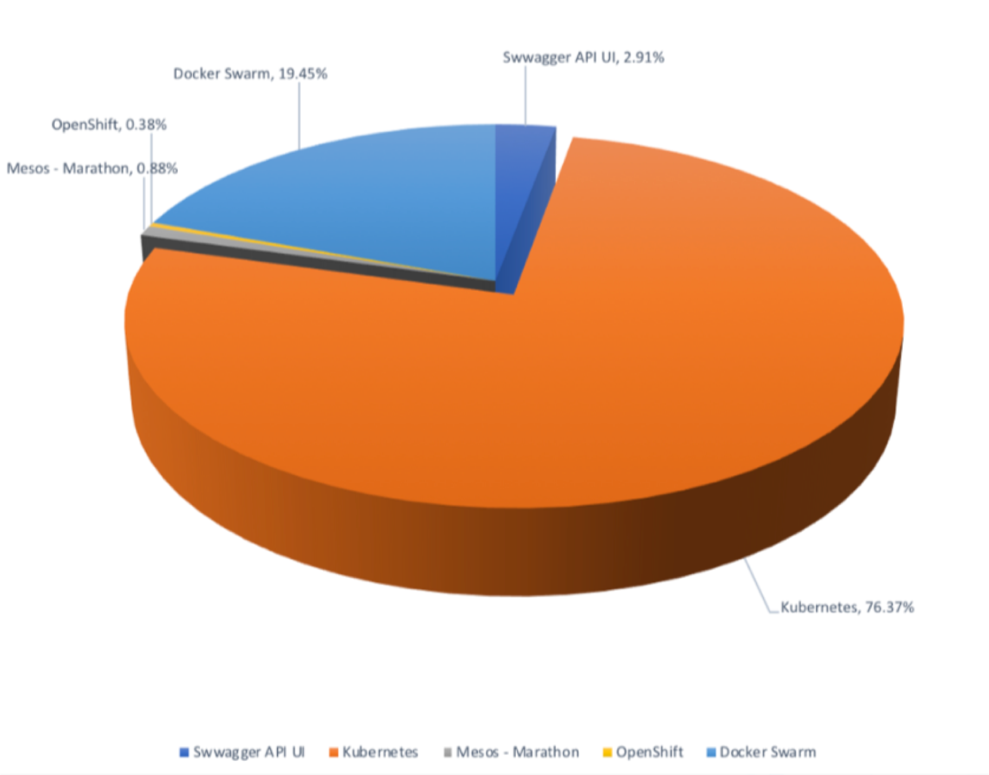
EXPOSED DASHBOARDS

Slide 13

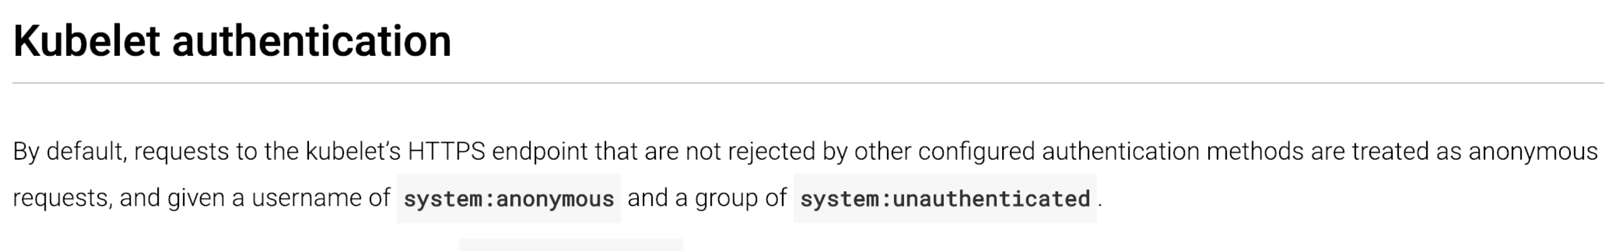

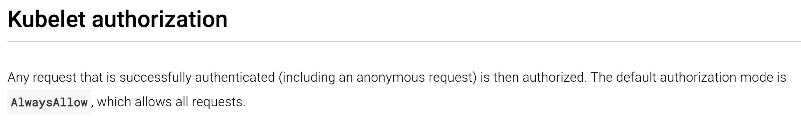
EXPOSED KUBELET

Slide 14

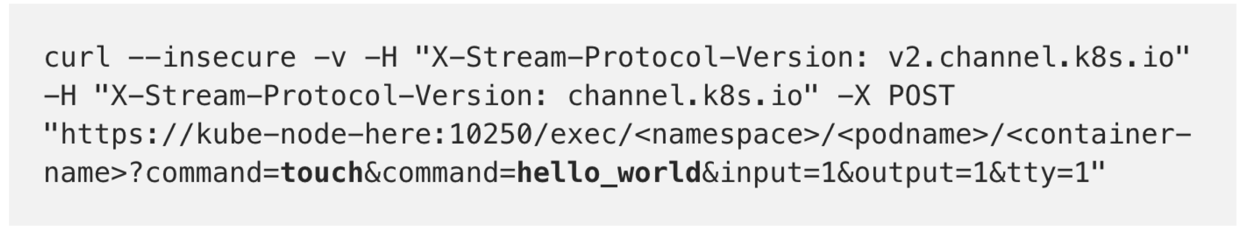
EXEC ON RUNNING CONTAINER THROUGH KUBELET
PoC by Security Engineer @ Handy (K8 v1.9)
Issue POST request to targeted Pod
Follow with GET request via SPDY or websocket client

Slide 15
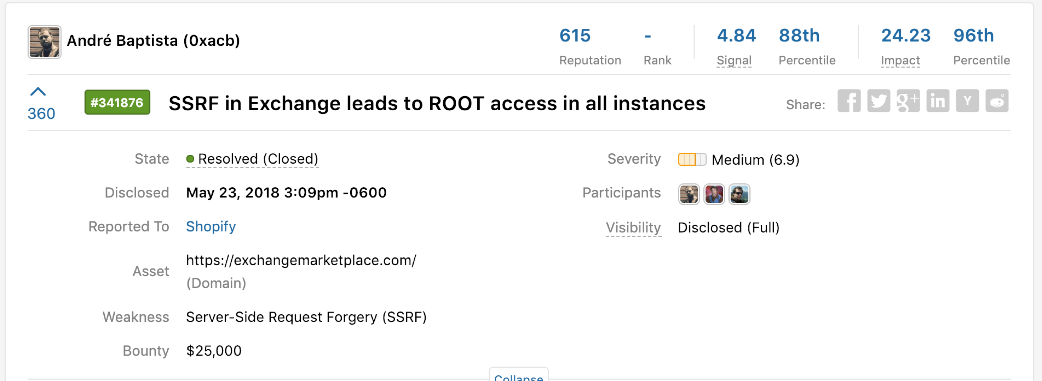
REPLAYING KUBELET CREDENTIALS
SSRF in vulnerable service used by Shopify
Kubelet credentials leaks via vulnerability
Credentials replayed to gain root access in any container

Slide 16


EXPOSED etcd
Distributed Key Value Data Store
No Authentication by Default
REST & gRPC APIs

Slide 17

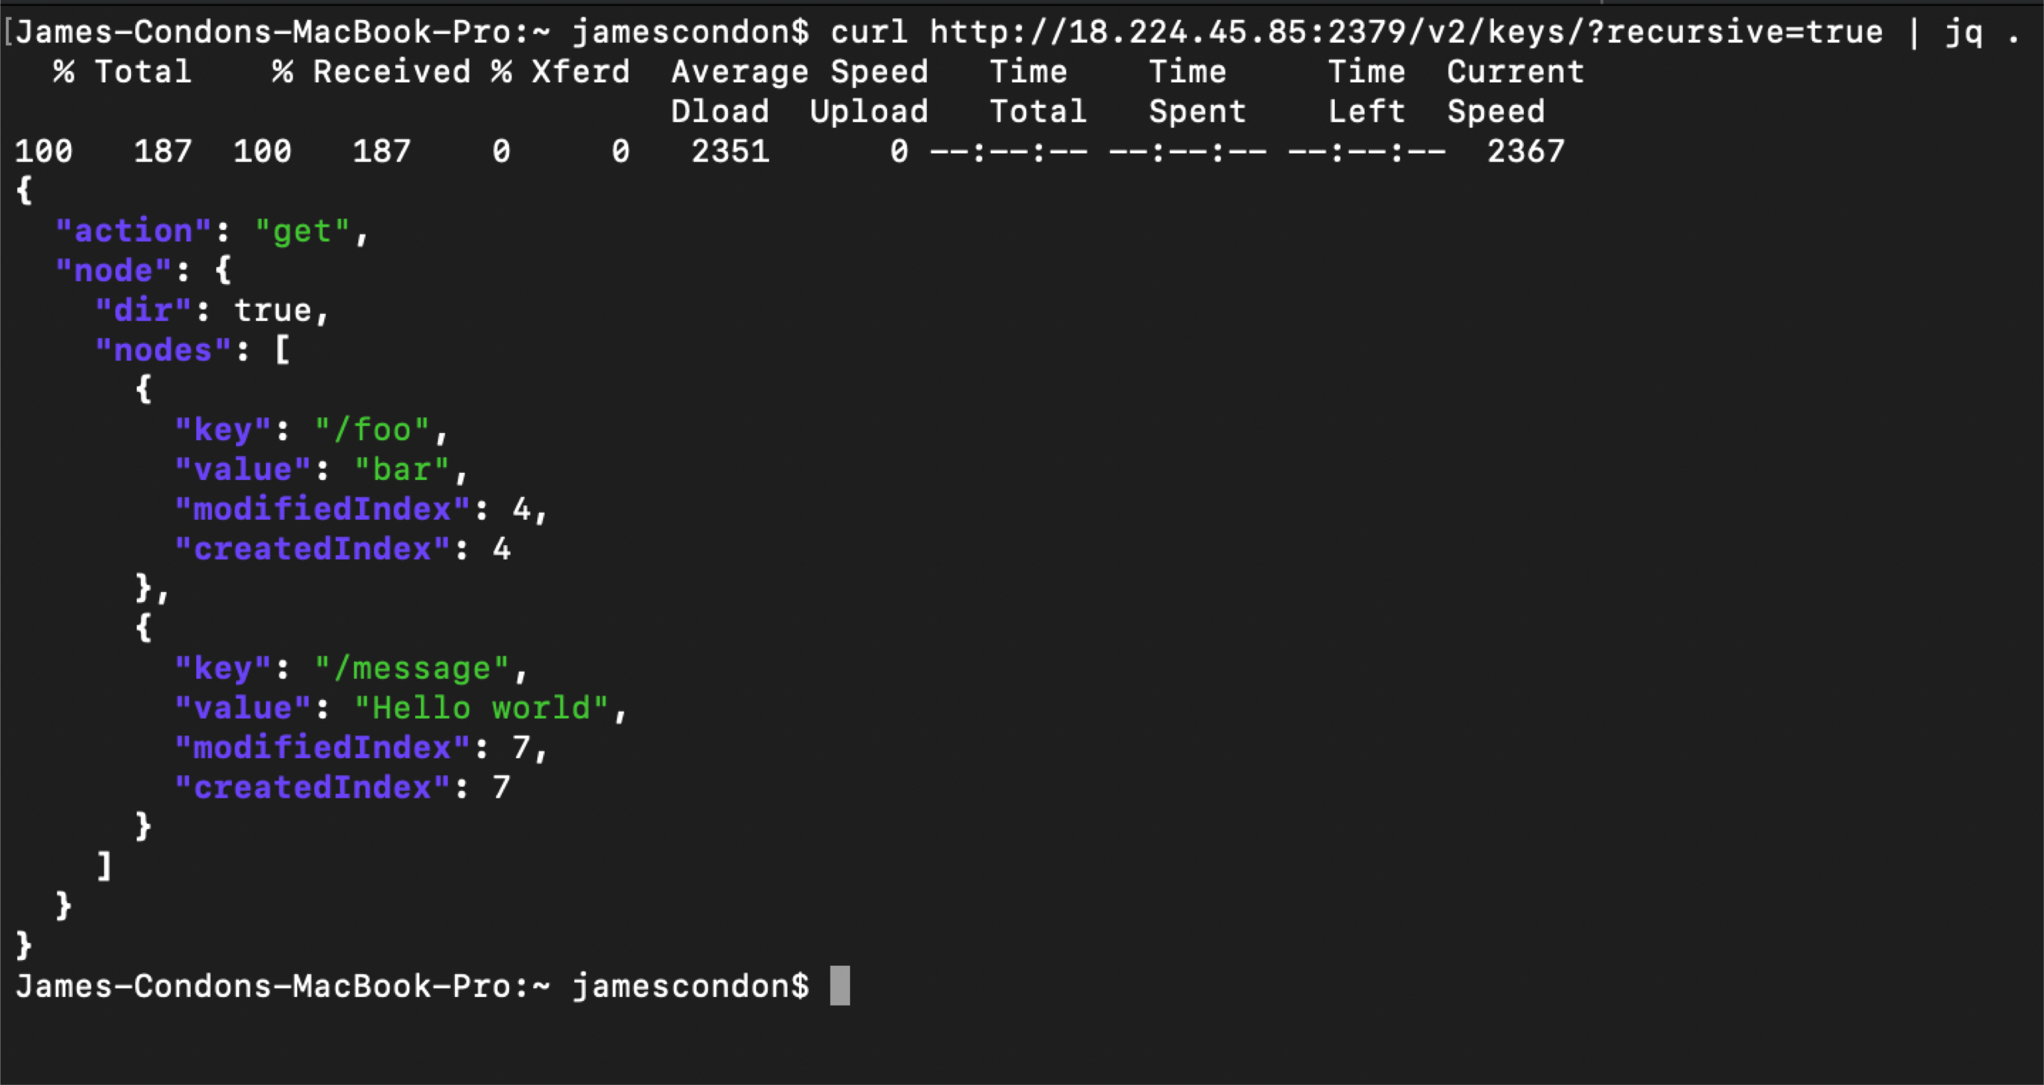

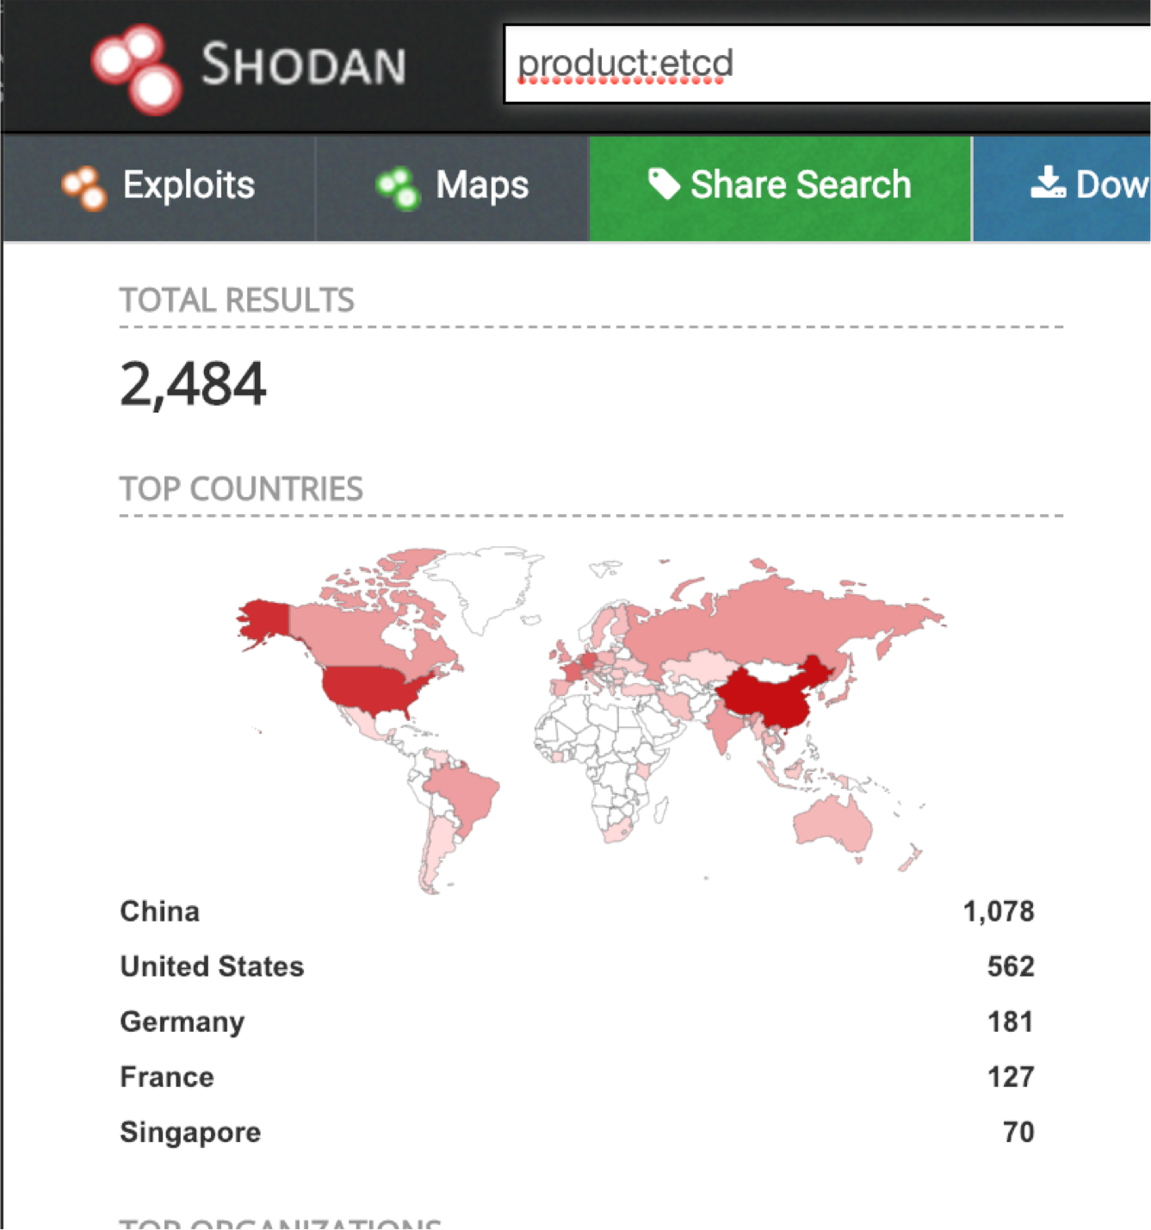
EXPOSED etcd DEMO

Slide 18
THREATS FROM WITHIN THE CLUSTER
Supply Chain Attacks
Known & Unknown CVEs
Application Vulnerabilities
Pod Compromise

Slide 19
LATERAL MOVEMENT: NODES
CVE-2017- 1002101
CVE-2017- 1002102
Privileged Containers
allows containers using subPath volume mounts to access files or directories outside of the volume, including the host’s filesystem
allows containers using certain volumes to trigger deletion of arbitrary files on the host filesystem
Options for accessing host system

Slide 20
LATERAL MOVEMENT: CLUSTER
CVE-2018- 1002105
Overprivileged Service Accounts
proxy request handling in kube- apiserver can leave vulnerable TCP connections
Authorization to create pods, deamonsets, etc.

Slide 21







Image Scanning
Security Saavy Dev <-> Saavy Security
RBAC
10
ESSENTIALS
SECURING K8S
Host Logging / HIDS
Security Boundaries
RT Compliance
/ Auditing
Upgrade
Audit Logging
POD Security Policies
Node Security Hardening

Slide 22
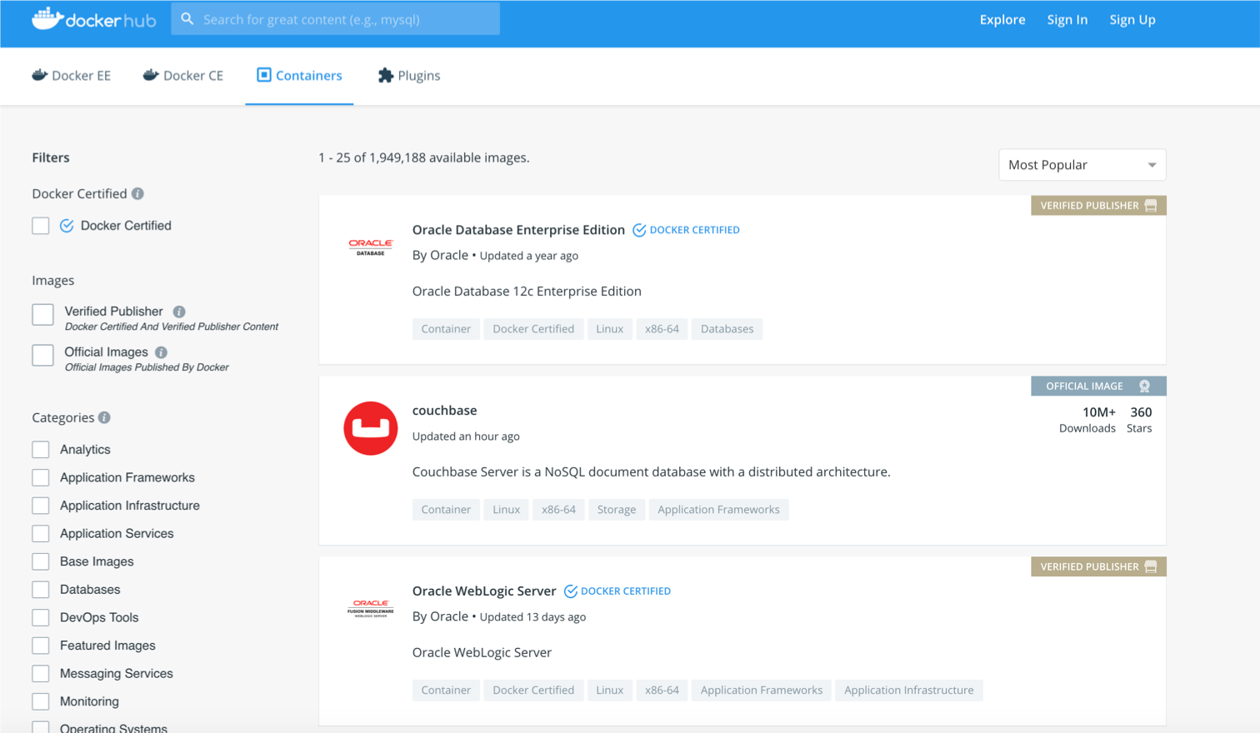
IMAGE SCANNING
Container vulnerability scans
Scan for poor configurations in containers Scan for keys in containers
Combine pre-deploy with runtime

Slide 23

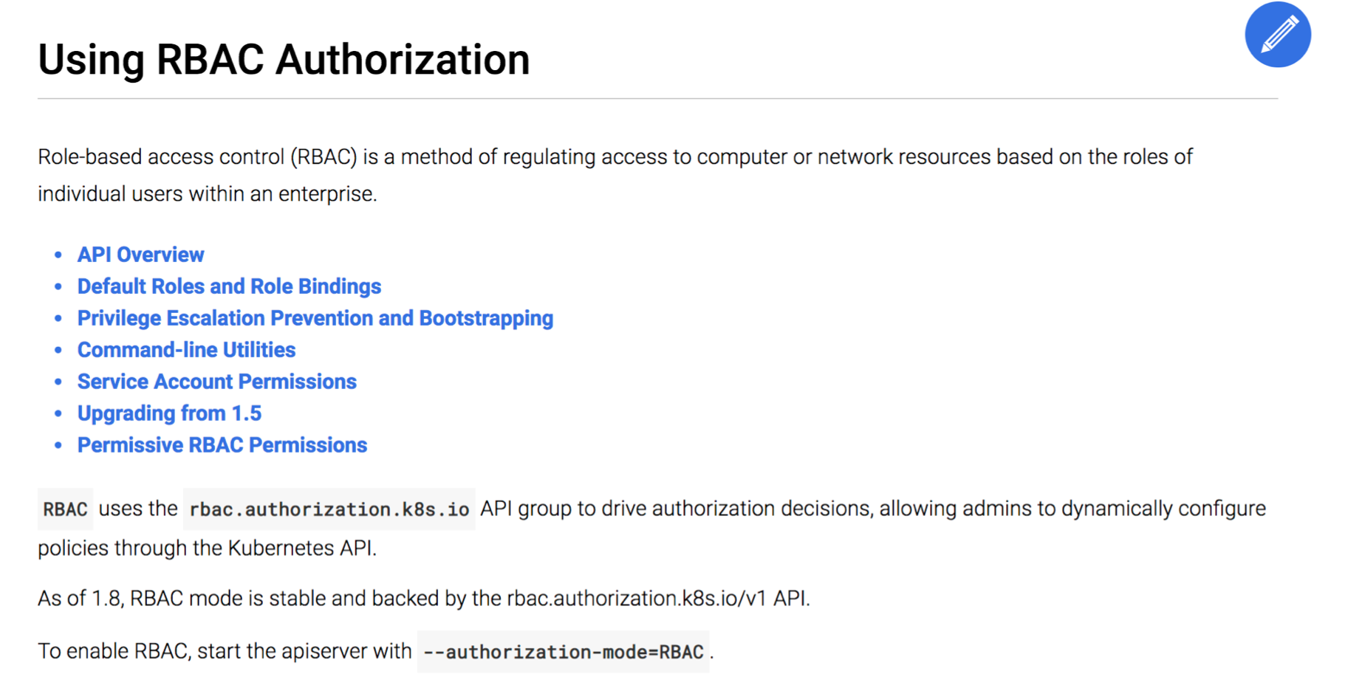
ROLE BASED ACCESS CONTROL
Critical for division on access Segregates roles and permissions Decreases attack surface

Slide 24

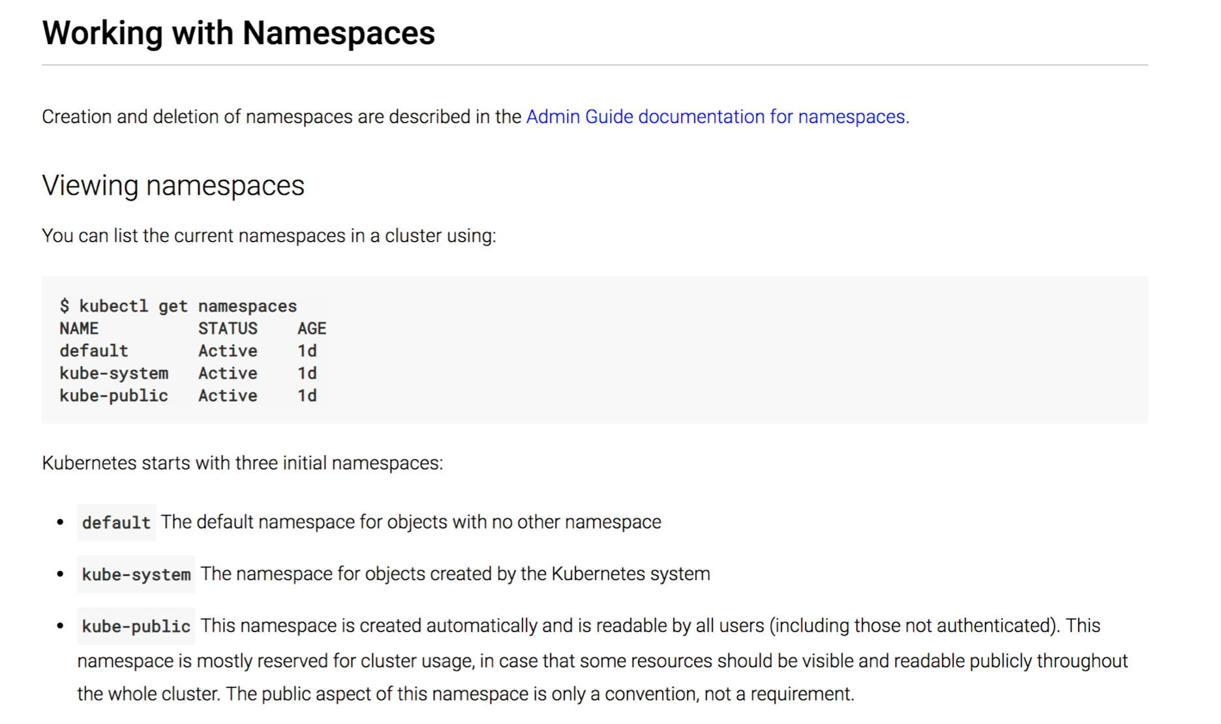
SECURITY BOUNDARIES
Utilize multiple namespaces Separate sensitive workloads Utilize node pools to separate Ex: kube-public

Slide 25


UPGRADE!
CVE-2018-1002105 DEMO
Upgrading should be seamless No runtime patching
Patch = redeploy
Vulnerabilities != vulnerable often

Slide 26

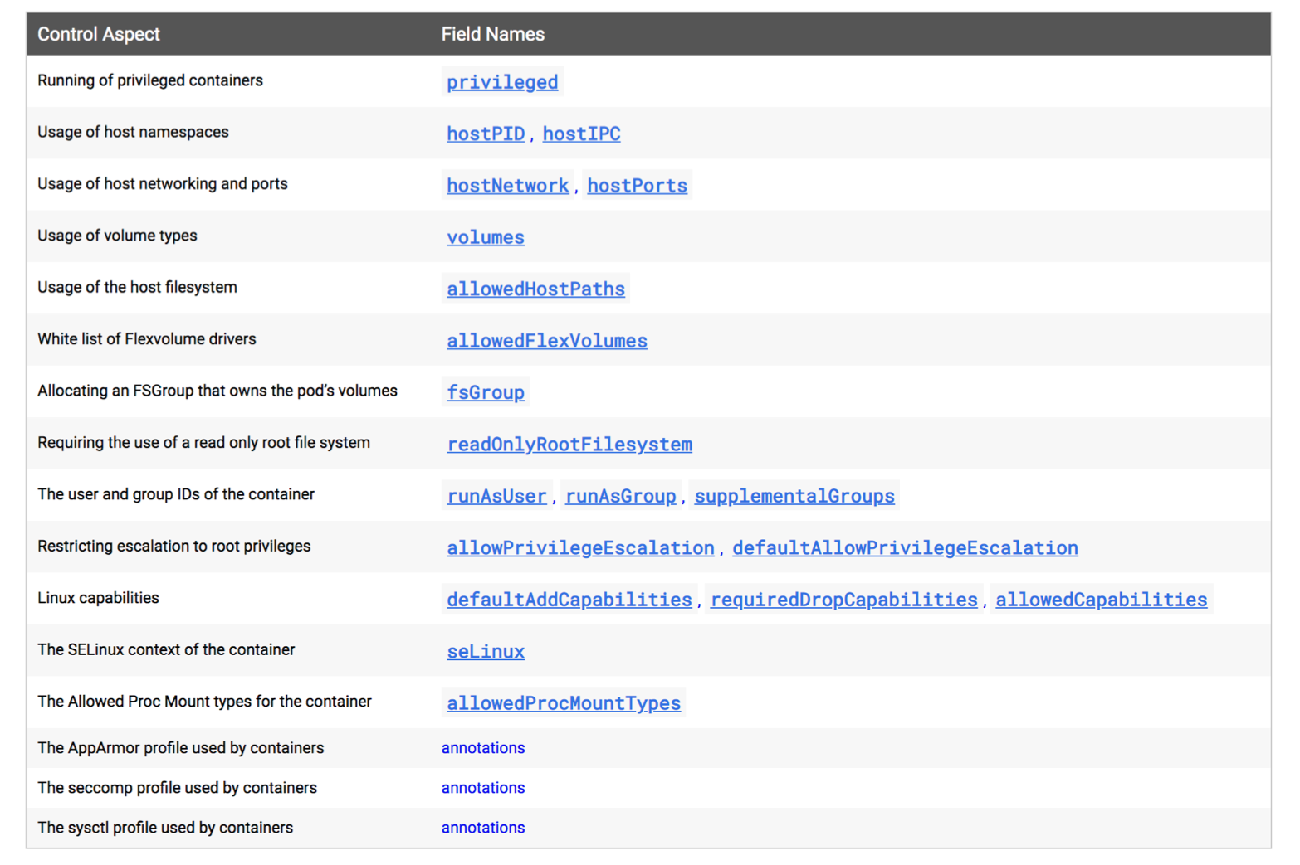
POD SECURITY POLICIES
Huge win in securing K8s Allow centralized cluster level
security controls / configuration Controls growing frequently

Slide 27

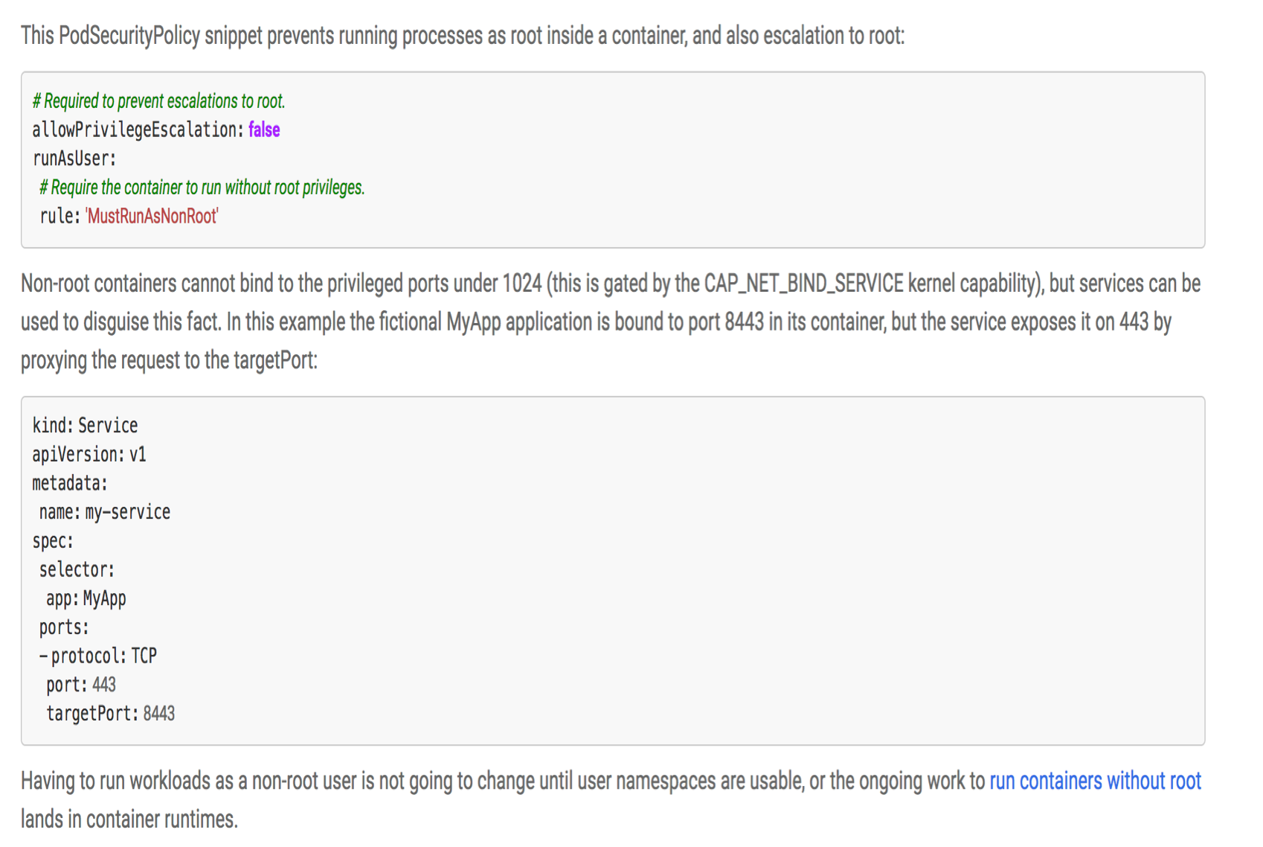
NODE SECURITY HARDENNING
Eliminate logins and “in-place” changes Read-only file systems
Least Privilege Consistent deployments
Atomic Deployment and Validation Run as non-root

Slide 28

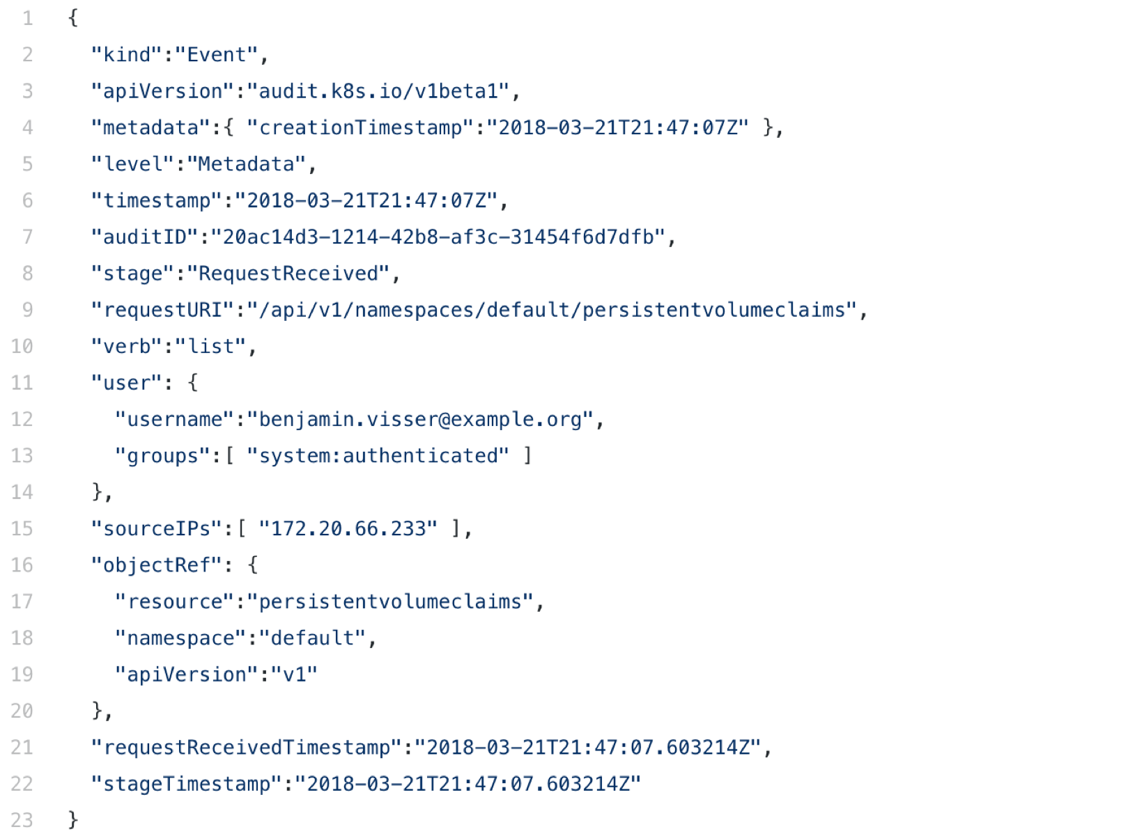
AUDIT LOGGING
Audit Logging for ALL API requests API is largest attack surface
Log as much as you can afford
Store, glacier, have them avail/query Audit logs big forensics firehouse

Slide 29
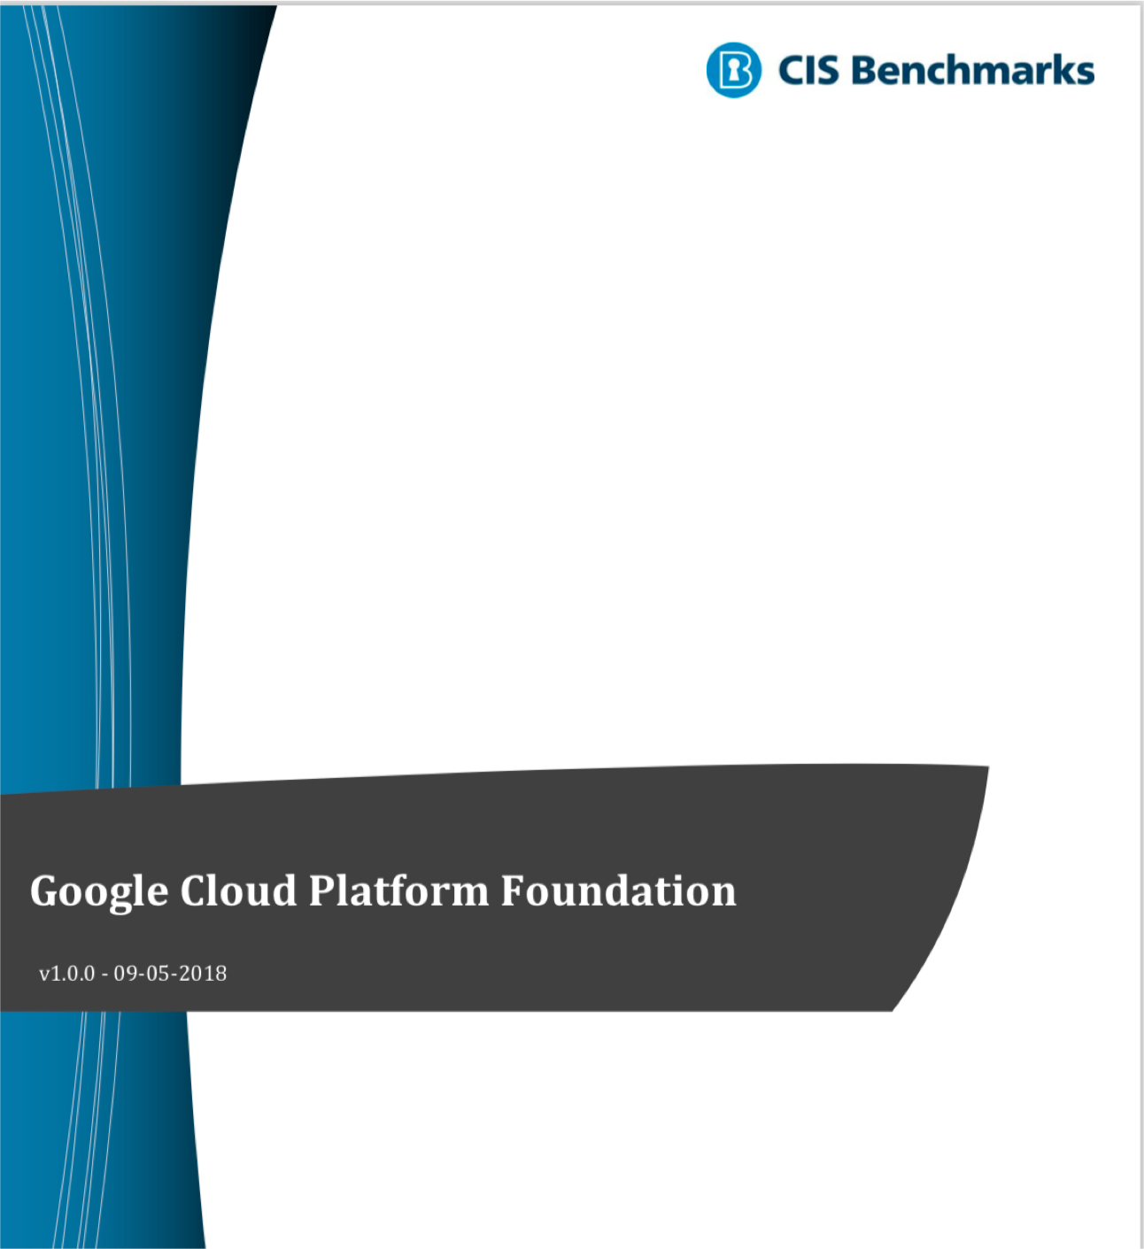
RT COMPLIANCE / CONFIG
Realtime / runtime auditing critical Infrastructure as code = wider paper cuts Security vulnerabilities often config’s Identify, alert, fix, measure (repeat)

Slide 30
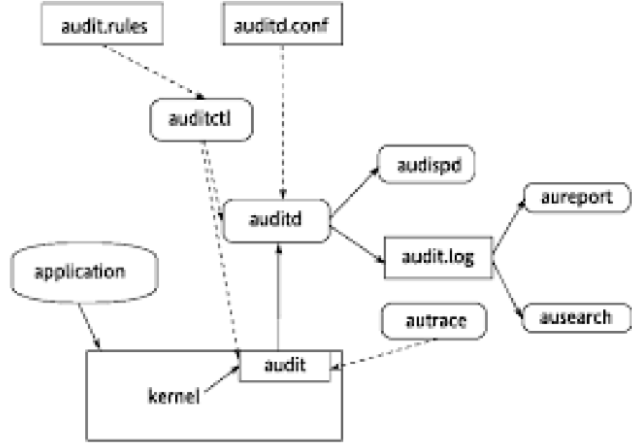
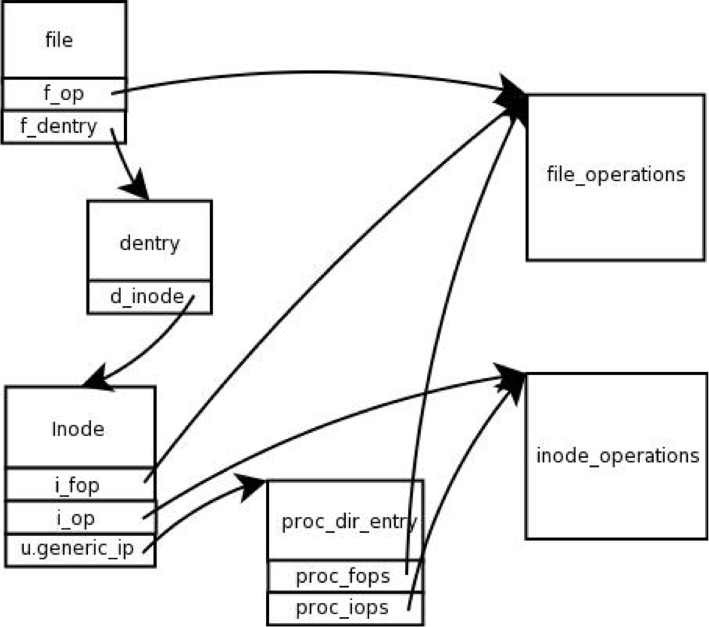
HOST LOGGING / HIDS / EDR
Ephemeral workloads make logging more important
Understand process, applications, network Building net “sensors” hard / blind Correlate IOC’s + events (ML+) Opensource + SaaS options
Build / buy centralized warehouse Auditd, /proc, pcap,etc..

Slide 31



SECURITY SAAVY DEV : DEV SAAVY SECURITY
The Firewall is the security!
Window of Opportunity
Least Privilege Immutable for All
YESTERDAY
TODAY
TOMORROW

Slide 32
resources
Tesla Exposed Dashboard https://redlock.io/blog/cryptojacking-tesla
Weight Watchers Exposed Dashboard https://kromtech.com/blog/security-center/weightwatchers-exposure-a-simple-yet-powerful-lesson- in-cloud-security
Lacework Containers at Risk Report https://info.lacework.com/hubfs/Containers%20At- Risk_%20A%20Review%20of%2021,000%20Cloud%20Environments.pdf
CVE-2018-1002105 Github Page https://github.com/kubernetes/kubernetes/issues/71411
Kubelet Reference Page https://kubernetes.io/docs/reference/command-line-tools-reference/kubelet-authentication-authorization/
Compromising Kubernetes Through Kubelet Blog https://medium.com/handy-tech/analysis-of-a-kubernetes-hack-backdooring-through- kubelet-823be5c3d67c
Shopify Hack https://hackerone.com/reports/341876
Exposed etcd Clusters Blog https://elweb.co/the-security-footgun-in-etcd/
Lacework exposed etcd Clusters Blog https://www.lacework.com/etcd-thousands-of-clusters-open/
Backdoored Docker Images https://arstechnica.com/information-technology/2018/06/backdoored-images-downloaded-5-million-times- finally-removed-from-docker-hub/
Twistlock Blog on CVE-2017-1002101https://www.twistlock.com/labs-blog/deep-dive-severe-kubernetes-vulnerability-date-cve-2017- 1002101/
Attacking and Defending a Kubernetes Cluster Webinar https://vimeo.com/277901517
Kubernetes Illustrated Children's Guide: https://youtu.be/4ht22ReBjno

